Slide 1
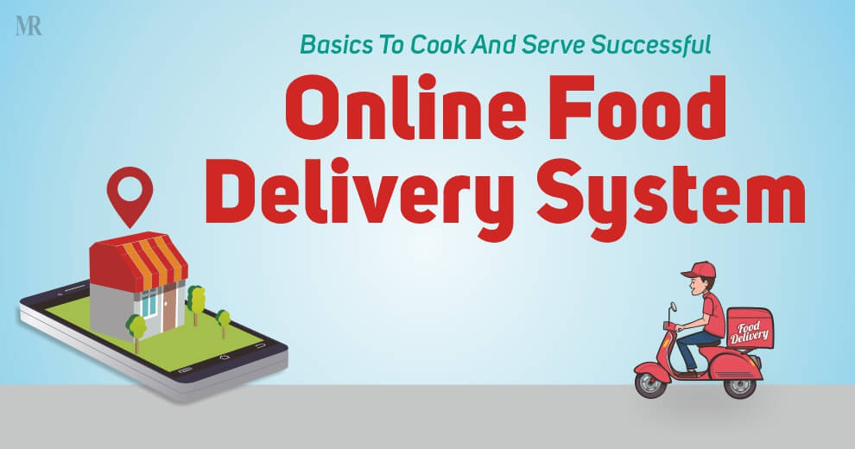
“ Food delivery website and application”

Slide 2
Food delivery website and application
▪
A food delivery app that provides food delivery at your door in very less time and with the best packaging.
LMS Username | Name | Batch
 | S.Vignesh | 02
 | M.Mugilanathan | 02
 | P.Yugandhar | 02
 | R.Mukesh | 02

Slide 3
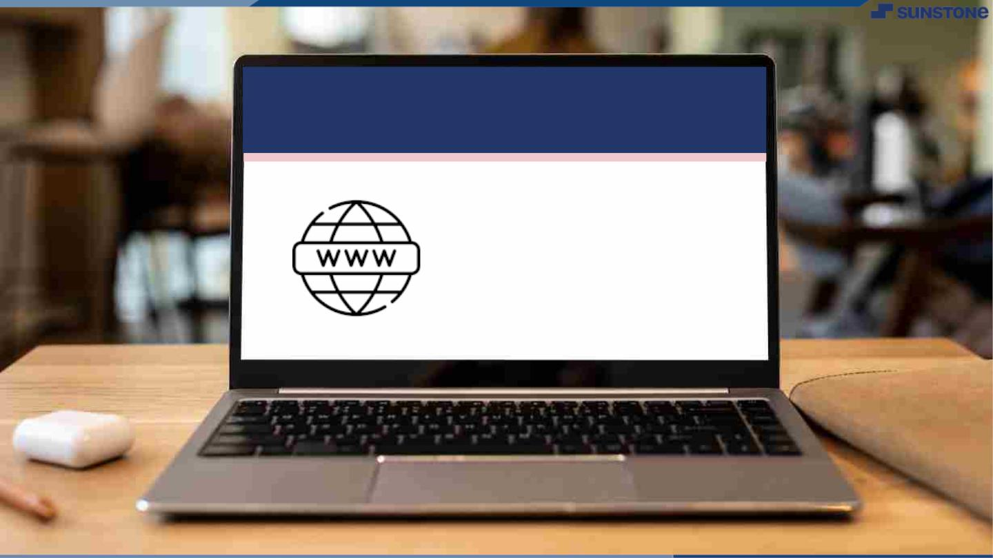
Submission Github
https://github.com/yugandhar1001/NM-SPCET-IT-GROUP02

Slide 4


